Slide 1
BASIC CONCEPTS

Slide 2
COMPUTER HARDWARE

Slide 3
What Is a Computer Hardware?
Computer hardware is composed of the following components: central processing unit (CPU), input devices, output devices, primary storage, secondary storage, and communication devices.
Input devices accept data & instructions and convert them to a form that the computer can understand.
Output devices present data in a form people can understand.
The CPU manipulates the data and controls the tasks done by the other components.
Primary storage (internal storage) temporarily stores data and program instructions during processing.
Secondary storage (external) stores data and programs for future use.
Communication devices provide for the flow of data between external computer networks.

Slide 4
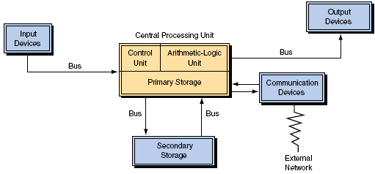
What Is a Computer System?

Slide 5
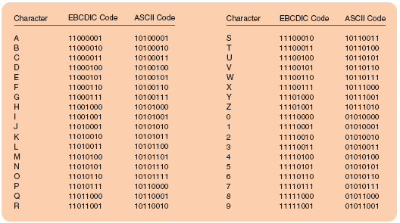
Binary Computers
Today’s computers are based on integrated circuits (chips), each of which includes millions of subminiature transistors. Each transistor can be in either an “on” or “off” state that is used to establish a binary 1 or 0 for storing one binary digit, or bit.
ASCII (American Standard Code for Information Interchange)
EBCDIC (Extended Binary Coded Decimal Interchange Code)

Slide 6
Units of Measure
Computer hardware is composed of the following components: central processing unit (CPU), input devices, output devices, primary storage, secondary storage, and communication devices.
Representing time and size of bytes. Time is represented in fractions of a second. The following are common measures of time:
Millisecond 11000 second
Microsecond 11,000,000 second
Nanosecond 11,000,000,000 second
Picosecond 11,000,000,000,000 second
Size is measured by the number of bytes. Common measures of size are:
Kilobyte 1,000 bytes (actually 1,024)
Megabyte 1,000 kilobytes 106 bytes
Gigabyte 109 bytes
Terabyte 1012 bytes
Petabyte 1015 bytes
Exabyte 1018 bytes

Slide 7
The Evolution Of Computer Hardware
Computer hardware has evolved through four stages, or generations, of technology. Each generation has provided increased processing power and storage capacity, while simultaneously exhibiting decreases in costs.
First generation of computers, from 1946 to about 1956, used vacuum tubes to store and process information.
Second generation of computers, 1957–1963, used transistors for storing and processing information.
Third-generation computers, 1964–1979, used integrated circuits for storing and processing information.
Early to middle fourth-generation computers, 1980–1995, used very large-scale integrated (VLSI) circuits to store and process information.

Slide 8
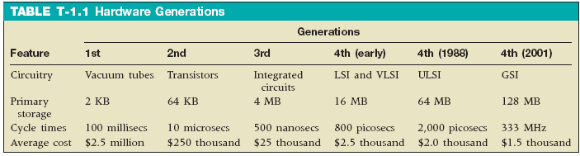
The Evolution Of Computer Hardware
Continued
Late fourth-generation computers, 1996 to the present, use grand-scale integrated (GSI) circuits to store and process information.
Fifth generation of computers use massively parallel processing to process multiple instructions simultaneously.

Slide 9

Types Of Computers
Computers are distinguished on the basis of their processing capabilities.
Supercomputers are the computers with the most processing power. The primary application of supercomputers has been in scientific and military work, but their use is growing rapidly in business.
Mainframes are not as powerful and generally not as expensive as supercomputers. Large corporations, where data processing is centralized and large databases are maintained, most often use mainframe computers.
Minicomputers are smaller and less expensive than mainframe computers. They are usually designed to accomplish specific tasks such as process control and engineering applications. Larger companies gain flexibility by distributing minicomputers in organizational units instead of centralizing at one location.

Slide 10
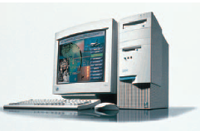
Types Of Computers Continued
Computers are distinguished on the basis of their processing capabilities.
Servers typically support computer networks, enabling users to share files, software, peripheral devices and other network resources. Server farms are large groups of servers.
Workstations provide high levels of performance to technical users such as designers and are typically based on RISC (reduced instruction set computing) architecture.
Microcomputers or personal computers (PCs), are the smallest and least expensive category of general-purpose computers. They may be subdivided into five classifications:
Desktops
Thin clients
Laptops
Notebooks,
Mobile devices

Slide 11
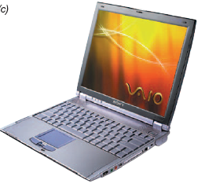
Types Of Computers Continued
Desktop personal computer is the typical, familiar microcomputer system.
Thin-client systems are desktop computer systems that do not offer the full functionality of a PC.
One type of thin client is the terminal
Another type of thin client is a network computer.
Laptop computers are small, easily transportable, lightweight microcomputers that easily fit into a briefcase
Notebooks are smaller laptops.
Mobile devices as handheld computers, often called personal digital assistants (PDAs) or handheld personal computers.

Slide 12
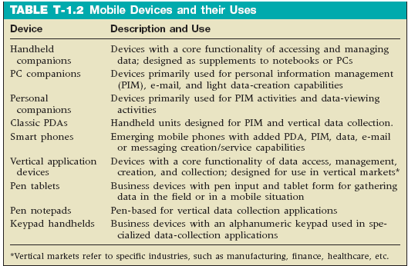
Types Of Computers Mobile Devices
Some mobile devices offer mapping capabilities using GPS. Global positioning systems

Slide 13

Types Of Computers Other Mobile Devices
Tablet PC technology runs touch-sensitive displays that you tap with a pen, forgoing a mouse or touch pad.
Wearable computers are designed to be worn and used on the body.
Embedded computers are placed inside other products to add features and capabilities.
Active badges are worn as ID cards by employees who wish to stay in touch at all times while moving around the corporate premises.
Memory buttons are nickel-sized devices that store a small database relating to whatever it is attached to.
Smart cards which has resulted from the continuing shrinkage of integrated circuits are similar in size and thickness to ordinary plastic credit cards. They contain a small CPU, memory, and an input/output device that allow these “computers” to be used in everyday activities such.

Slide 14
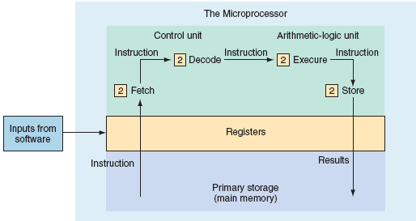
The Microprocessor
The central processing unit (CPU) is the center of all computer-processing activities, where all processing is controlled, data are manipulated, arithmetic computations are performed, and logical comparisons are made.
The CPU consists of the
Control unit
Arithmetic-logic unit (ALU)
Primary storage (or main memory)

Slide 15
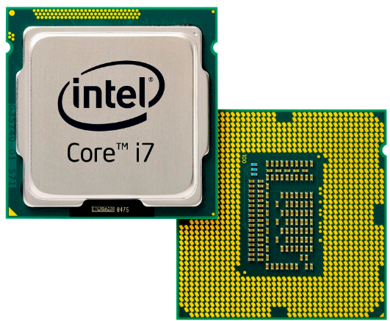
Source: https://electrosome.com/wp-content/uploads/2017/04/Intel-Core-i7.jpg

Slide 16
The Machine Instruction Cycle
The cycle of processing is called the machine instruction cycle and it speed depends on the following four factors of chip design:
The preset speed of the clock that times all chip activities, measured in mega­hertz (MHz), millions of cycles per second, and gigahertz (GHz), billions of cycles per second. The faster the clock speed, the faster the chip.
The word length, which is the number of bits (0s and 1s) that can be processed by the CPU at any one time. The majority of current chips handle 32-bit word lengths, and the Pentium 4 is designed to handle 64-bit word lengths. The larger the word length, the faster the chip.
The bus width. The wider the bus (the physical paths down which the data and instructions travel as electrical impulses), the more data can be moved and the faster the processing. A bus transfers data is measured in megahertz.
The physical design of the chip - the distance between transistors is known as line width. The smaller the line width, the more transistors can be packed onto a chip, and the faster the chip.

Slide 17
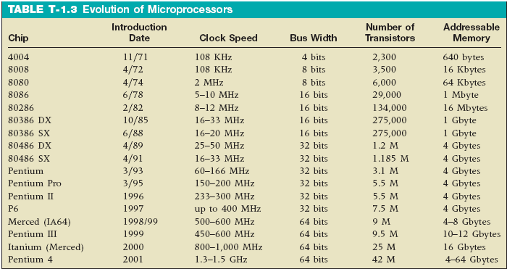
Evolution Of The Microprocessor
Moore’s Law - Gordon Moore’s 1965 prediction that microprocessor complexity would double approximately every two years is based on the following changes: Increasing miniaturization of transistors, Compacting the physical layout of the chip’s components (decreasing line width) and using better conducting materials.

Slide 18
Computer Architecture
The arrangement of the components and their interactions is called computer architecture. Computer architecture includes the instruction set and the number of the processors, the structure of the internal buses, the use of caches, and the types of input/output (I/O) device interfaces.
An instruction set is the set of machine instructions that a processor recognizes and can execute. Complex instruction set computers (CISC) and reduced instruction set computers (RISC), dominate the processor instruction sets of computer architectures.
A CISC processor contains more than 200 unique coded commands, one for virtually every type of operation.
The other, a more recent approach is RISC processors, which eliminate many of the little-used codes found in the complex instruction set.

Slide 19
Primary Storage
Primary storage, or main memory, stores data and program statements for the CPU. It has four basic purposes:
To store data that have been input until they are transferred to the ALU for processing.
To store data and results during intermediate stages of processing.
To hold data after processing until they are transferred to an output device.
To hold program statements or instructions received from input devices and from secondary storage.

Slide 20
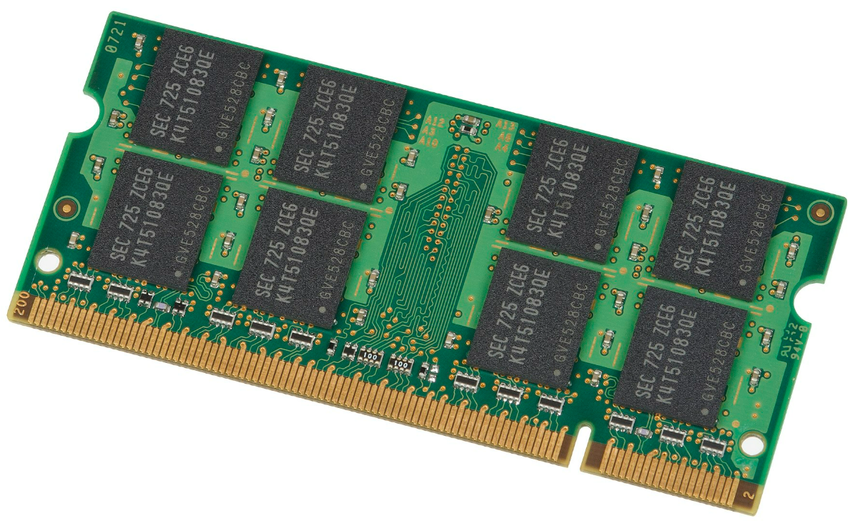
Primary Memory/Example
Source: https://upload.wikimedia.org/wikipedia/commons/thumb/2/2c/Samsung-1GB-DDR2-Laptop-RAM.jpg/1920px-Samsung-1GB-DDR2-Laptop-RAM.jpg

Slide 21
Categories Of Memory
There are two categories of memory: the register, which is part of the CPU and very fast and the internal memory chips, which reside outside the CPU and are slower. The control unit, the CPU, and the primary storage all have registers. Small amounts of data reside in the register for very short periods, prior to their use. Internal memory is used to store data just before they are processed by the CPU. Immediately after the processing it comprises two types of storage space: RAM and ROM.
Random-access memory (RAM) is the place in which the CPU stores the instructions and data it is processing.
Dynamic random access memories (DRAMs)
Synchronous DRAM (SDRAM)
Read-only memory (ROM) is that portion of primary storage that cannot be changed or erased. ROM is nonvolatile.
Programmable read-only memory (PROM)
Erasable programmable read-only memory (EPROM)

Slide 22
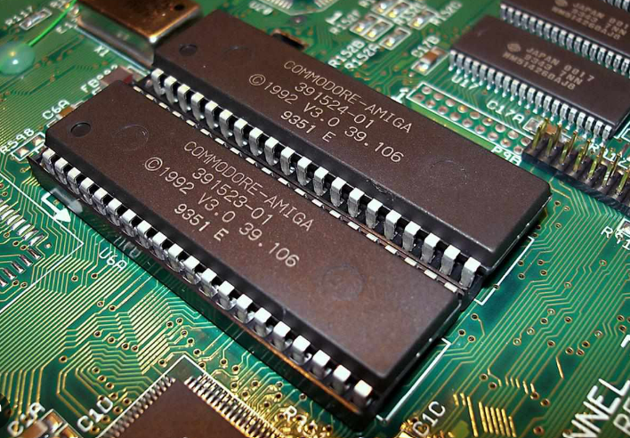
Source: https://www.thoughtco.com/thmb/5RddHAxNx3JcH7PdKG4GtbV6LS8=/1500x0/filters:no_upscale():max_bytes(150000):strip_icc()/Amiga_1200_Kickstart_3.0_ROMs-56b429575f9b5829f82c66bd.jpg

Slide 23
The Control Unit
The control unit reads instructions and directs the other components of the computer system to perform the functions required by the program. The control unit does not actually change or create data; it merely directs the data flow within the CPU.
It interprets and carries out instructions contained in computer programs
Selects program statements from the primary storage
Move program statements to the instruction registers in the control unit
Controls input and output devices
Handles data-transfer processes from and to memory.

Slide 24
Buses
A bus is a channel (or shared data path) through which data are passed in electronic form. Three types of buses link the CPU, primary storage, and the other devices in the computer system. The capacity of a bus, called bus width, is defined by the number of bits they carry at one time.
The data bus moves data to and from primary storage.
The address bus transmits signals for locating a given address in primary storage.
The control bus transmits signals specifying whether to “read” or “write” data to or from a given primary storage address, input device, or out­put device.

Slide 25
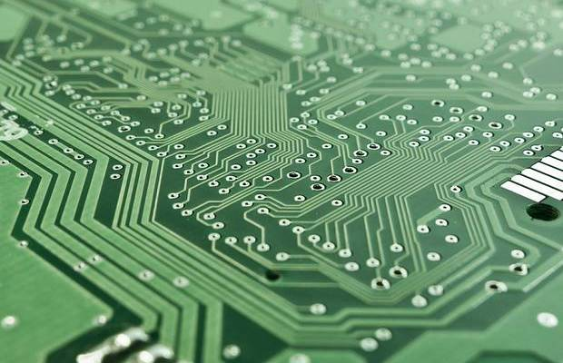
Example
Source: https://abidtechtips.files.wordpress.com/2018/05/on-ca442_semich_b620_20170303125808.jpg

Slide 26
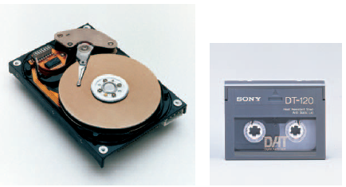
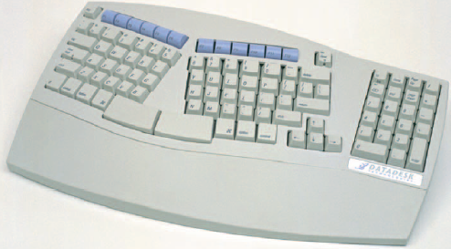
Input/Output Devices
The input/output (I/O) devices of a computer are not part of the CPU, but are channels for communicating between the external environment and the CPU. I/O devices are controlled directly by the CPU or indirectly through special processors dedicated to input and output processing.
Secondary storage
Peripheral Devices

Slide 27
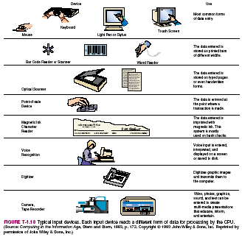
Input Devices

Slide 28
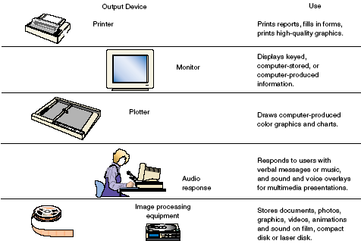
Output Devices

Slide 29
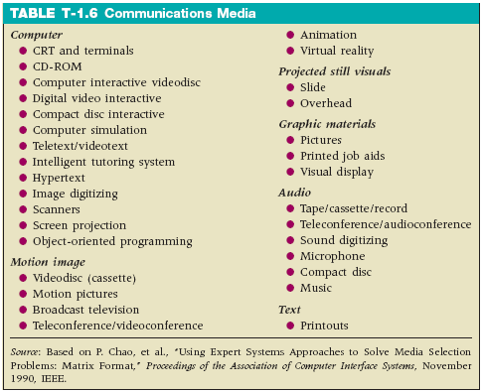
Communications Media

Slide 30
COMPUTER SOFTWARE

Slide 31
Types Of Software
Computer hardware cannot perform a single act without instructions. These instructions are known as software or computer programs. There are two major types of software: application software and systems software.
Application software is a set of computer instructions, that direct computer hardware to perform specific data or information processing activities that provide functionality to the user.
Systems software acts primarily as an intermediary between computer hardware and application programs, and provides important self-regulatory functions for computer systems, such as loading itself when the computer is turned on, managing hardware resources such as secondary storage for all applications; and providing commonly used sets of instructions for all applications to use.

Slide 32
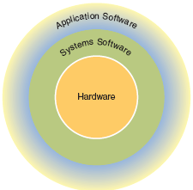
Types Of Software
Unlike computer hardware, which can be designed and manufactured on automated assembly lines, most software must be programmed by hand.
Both application software and systems software are written in coding schemes called programming languages.

Slide 33
Application Software
Because there are so many different uses for computers, there are a correspondingly large number of different application programs.
Tailor-made application software addresses a specific or unique business need for a company.
Off-the-shelf application software can be purchased, leased, or rented from a vendor that develops programs and sells them to many organizations (Vertical Markets).
General-purpose application programs that are not linked to any specific business task, but instead support general types of information processing
Spreadsheet
Data management
Word processing
Desktop publishing
Graphics
Multimedia
Communications
Development tools - software used to construct applications

Slide 34
Application Software Continued
Spreadsheet software transforms a computer screen into a ledger sheet, or grid. Packages include already-programmed statistical, financial, and other business formulas and are primarily used for decision support processing.
Data management software supports the storage, retrieval, and manipulation of data. There are two basic types of data management software:
Simple filing programs patterned after traditional, manual data filing techniques
Database management systems (DBMS's) a collection of files serving as the data resource for computer-based information systems.
Word processing software allows the user to manipulate text rather than just numbers.

Slide 35
Application Software Continued
Desktop publishing software allows microcomputers to create newsletters, announcements, advertising copy, and other specialized documents by combining photographs, diagrams, and other images with text to produce a finished, camera-ready document.
Graphics software allows the user to create, store, and display or print charts, graphs, maps, and drawings.
Multimedia. There are two general types of multimedia software:
Presentation software presents a sequential procession of information similar to a movie or television show.
Interactive software allows a user to alter the sequence or flow of information, similar to looking at an encyclopedia or a photo album.

Slide 36
Application Software Continued
Communications software allows computers located close together or far apart to exchange data over dedicated or public cables, telephone lines, satellite systems, or microwave circuits.
Speech-recognition software translates voice patterns into text. There are two types:
Discrete speech recognition can interpret only one word at a time, so users must place distinct pauses between words.
Continuous speech recognition can interpret a continuing stream of words.
Software suites are collections of application software packages bundled together.
Workgroup software helps groups and teams work together by sharing information and by controlling workflow within the group. Products are designed to support tasks such as:
Project management
Scheduling (called calendaring)
Workflow
Retrieving data from shared databases

Slide 37
Application Software Continued
There exist hundreds of other application software products.
Middleware is software designed to link application modules developed in different computer languages and running on heterogeneous platforms.
Enterprise software consists of programs that manage the vital operations of an organization (enterprise), such as:
Supply-chain management
Inventory replenishment
Ordering
Human resources management
Manufacturing
Operations
Accounting and financial management.

Slide 38
Application Software Continued
There exist hundreds of other application software products.
Componentware is a term to describe a form of application software, in which each program manages one type of operation
Presence technology can detect when you’re online and what kind of device you’re using.
Schematics software can create schematics, space plans, layouts, etc.
Many more …

Slide 39
Systems Software
Systems software is the class of programs that controls and supports the computer hardware and its information processing activities. It also facilitates the programming, testing, and debugging of computer programs.
Systems software can be grouped into three functional categories:
System control programs are programs that control the use of hardware, software, and data resources of a computer system during its execution of a user’s information processing job. An operating system is the prime example.
System support programs support the operations, management, and users of a computer system by providing a variety of services. System utility programs, performance monitors, and security monitors are examples.
System development programs help users develop information processing programs and procedures and prepare user applications. Language compilers, interpreters, and translators are examples.

Slide 40
Application Software are software with a specific function to produce, such as word processing, spreadsheet, presentation, graphics, and video editing
Software | Functionality
Wordprocessor | This software specializes on word processing such as producing text, documents, letters, calling cards, brochures, leaflets and memorandum.
Spreadsheet | This software is similar to an accounting system and can use formulas, for are grading, inventory, payroll, billing, registration and voting system. It is also equipped with creating graphs such as line, bar and pie chart.
Presentation | This software is useful in presentations such as business proposals, corporate meetings, seminars and educational activities.
Graphics | This software specializes in editing images. Common types of image file formats are: .JPG (.JPEG Joint Photographic Experts Group), .BMP (Bitmap) and .GIF (Graphics Interchange Format).

Slide 41
Application Software
Software | Functionality
Sound Editor | This software enhances sound, such music mixing, clearing sounds, converting music and sound effects.
Video Editor | This software is primarily use is to edit videos. One of its functionality is rendering text, images, sound and animation.
Publisher | This software is primarily design to published newspapers, journals, magazines, and books.

Slide 42
System Software are software that help and supports the operating system in maintaining the computers: Here are notable system software and their area of functionality
Software | Functionality
Scandisk | This software are primarily designed to check the integrity of the system. It checks if there are possible bad sectors in the cluster of the array of data installed in the system unit.
Disk Defragmenter | This software is used to re-arrange the cluster and sector to each category it is related. Therefore, it helps in speeding up the activities in the system unit.
Anti-Virus | This software is used to disinfect or remove computer virus thus helping the system unit process data without virus corruption.

Slide 43
Programming Software these are software that is used to create customized systems that are the requirements specified by an entity for its primary purpose. A programming language is a set of instructions needed to direct and control a system
Programming Software these are software that is used to create customized systems that are the requirements specified by an entity for its primary purpose. A programming language is a set of instructions needed to direct and control a system
Customized system | Functionality
Payroll System | This customized system is used for computing the salary of employees of a certain business or profession.
Inventory System | This customized system is used for organizing the stocks of an entities equipment, merchandise and assets.
Registration System | This customized system is used for controlling records such as personal profiles, attendance monitoring, and scheduling activities of an entity.

Slide 44
Programming Software
Billing System | This system is used for computing the consumption of an entity such as electricity, water, communication, and internet service.
Sales System | This system is used for sales and retail where the real time computation of transactions is done.
Voting System | This customized system is used for computing voters turn out similar to a survey system where the candidates votes are tallied. It usually includes a chart for graphic analysis.
Crime System | This customize system is used to record, analyze and interpret data that are related with crimes. It usually is used by authorities like the police and criminal investigation agencies.
Accounting System | This system is for accounting processes such as trial balancing, sales/ expenses and assets monitoring. It is very helpful in speeding up and producing accurate accounting methods.

Slide 45
Package Software refers to software that are bundled with the Operating or System software. Here are some examples of package software
Software | Functions
Computer Games | This software are usually bundled with any electronic gadgets such operating system or customized built by programmers using sophisticated programming languages. Games nowadays are either 2D or 3D in form. There are embedded programs in microchip that are used for virtual reality type of games.
Calculator | This miniature program is bundled to any operating system in the market and function just as a normal calculator with extra features as add-ons.
Calendar | This miniature programs are bundled to any operating system that gives the user the features of a common calendar and a schedule organizer at the same time.
Media player | This program is used to play music or videos normally attached to a folder called accessories.

Slide 46
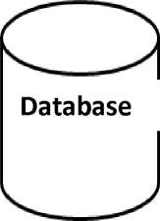


Database Software these refers to software for storing large volumes of information and controlling purposes is one of its features. A common database software has a table that is used in partitioning the data or files. Here is a simple graphical idea of how a database software works
Text
Images
Sound
Videos
Text
Images
Sound
Videos

Slide 47
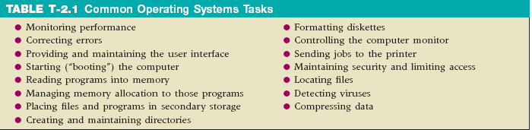
Operating Systems
The main component of systems software is a set of programs collectively known as the operating system. It supervises the overall operation of the computer, including monitoring the computer’s status, handling executable program interruptions, and scheduling operations, which include the controlling of input and output processes.

Slide 48
Operating Systems Continued
The operating system performs three major functions in the operation of a computer system.
Job management is the preparing, scheduling, and monitoring of jobs for continuous processing by the computer system.
Resource management is controlling the use of computer system resources employed by the other systems software and application software programs being executed on the computer.
Data management is the controlling of the input and output of data as well as their location, storage, and retrieval.

Slide 49
Operating Systems Continued
A variety of operating systems are in use today. The operating system used on most personal computers is some version of Microsoft’s Windows
Windows
UNIX
Linux
Mac OS X
JavaOS
Pocket PC
OS/390
OS/400
AIX
Sample Operating Systems

Slide 50
System Supports Programs
System utilities are programs that have been written to accomplish common tasks such as sorting records, merging sets of data, checking the integrity of magnetic disks, creating directories and subdirectories, restoring accidentally erased files, locating files within the directory structure, managing memory usage, and redirecting output.
System performance monitors - monitor computer system performance and produce reports containing detailed statistics on the use of system resources, such as processor time, memory space, I/O devices, and system and application programs.
System security monitors are programs that monitor the use of a computer system to protect it and its resources from unauthorized use, fraud, or destruction. It also controls the use of the hardware, software, and data resources of a computer system.

Slide 51
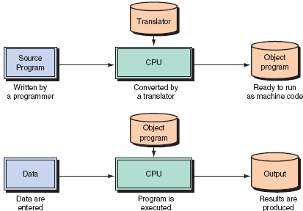
System Development Programs
Systems Development Programs, compilers or interpreters, translate programs (source code) written in a high level language into object or machine level code (binary).
Translation Programs

Slide 52
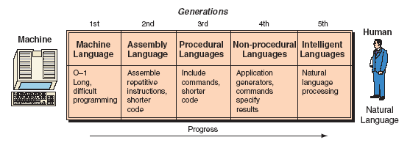
Programming Languages
Programming languages provide the basic building blocks for all systems and application software. Programming languages allow people to tell computers what to do and are the means by which systems are developed. Programming languages are basically a set of symbols and rules used to write program code. Each language uses a different set of rules and the syntax that dictates how the symbols are arranged so they have meaning.
The Evolution of Programming Languages

Slide 53
Programming Languages Continued
Machine Language (1st Generation)
Binary Code (1101)
Actual Wire Connections
Today we compile down to native code
Assembler Language (2nd Generation)
Symbolic Code acronyms (ADD Z)
Today we still program system level
Many HL store as intermediate code.
High-Level Languages (3rd Generation)
Statements
Compilers
Interpreters
COBOL (Common Business Oriented Language)
Basic (Beginners All-purpose Symbolic Instruction Code)
FORTRAN (Formula Translator)
C AT&T Bell Lab’s
Source Code
Interpreter
Results
Compiler
Object
Code
machine

Slide 54
Programming Languages Continued
Object Oriented Languages
Visual Basic (Exe)
Java (JVM)
C++ (Compiled)
Object COBOL (Compiled)
?ML (Markup Languages)
HTML, DHTML, XML, WML (Software Servers)
(CF, ASP) (Software Servers)
Source Code
Interpreter
Results
Compiler
Object
Code
machine

Slide 55
Programming Languages Continued
4GL 4th Generation Language
SQL, Query Languages Or Natural Language
Report Generators
Graphics Tools
Application Generators (“Wizards”)
Very High-Level Pgm. Languages (APL)
Application Language (Application Software
Data mining languages
Painters (NetObjects, Dreamweaver, )
“End-user” Languages
Spreadsheets
Word Processing
Desktop Publishing
Data management (Access)
Presentations
Source Code
Interpreter
Results
Compiler
Object
Code
machine

Slide 56
Case Tools
Computer-aided software engineering (CASE) is a tool for programmers, systems analysts, business analysts, and systems developers to help automate software development and at the same time improve software quality. It is a combination of software tools and structured software development methods.
CASE tools have several advantages:
CASE improves productivity by helping the analyst understand the problem and how to solve it in an organized manner.
CASE facilitates joint application and design (JAD) sessions, resulting in better interaction among users and information systems professionals.
CASE makes it easier to create prototypes, so that users can see what they are going to get at an early stage in the development process.
CASE makes it easier to make system design changes as circumstances change.

Slide 57
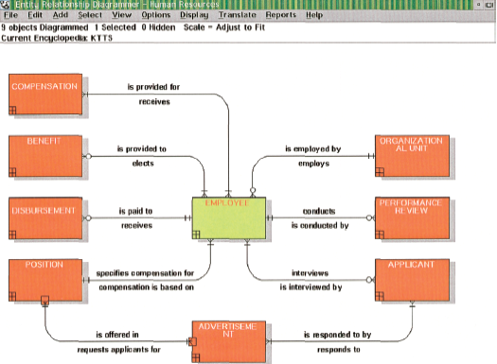
Case Tools Continued

Slide 58
REFERENCES
Patterson, David A. (2017) Computer Organization and Design: Hardware and Software Interface

Slide 60
Seatwork No. 1
What is a computer? (5 points)
Two Primary Parts of Computer System (5 pts)
Give 5 examples of hardware
Give 5 examples of software

